Slide 1
Fall 2021 Precalc
Lesson 16.3
Dr. O’Brien
Herbert H. Lehman High School
12 January 2022

Slide 2
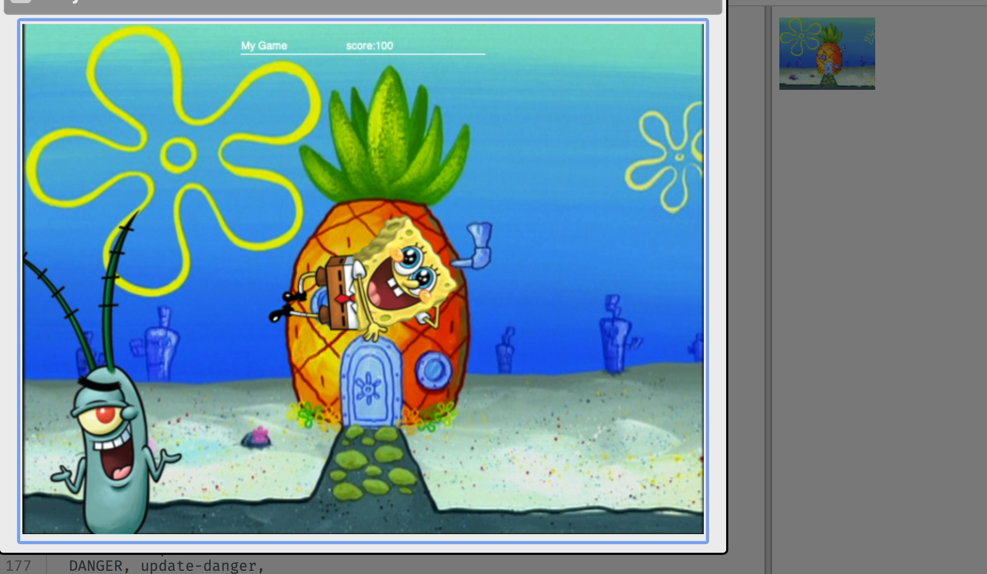
Do now
Be sure to:
Find a seat near the front. Get out your notebook and binder. Copy today’s goal.
Read the expectations to your right.
Write down any questions you have.
How to complete your Video Game Project:
Complete all the requirements for the grade you’re most happy with.
Every student should submit their own code for the video game (even if you worked with a partner). Indicate in the code who you worked with.
If your partner is absent, save your own copy of the game template file. Work on parts of the game that aren’t finished yet.
After you’re down coding, submit on Google Classroom and complete the Pyret Game Reflection Questions Google form.
Notes:
At the end, have students who are finished with everything, stay at the desks to talk through the extra credit problem together.

Slide 3
B24 rules
Welcome to our new room, B24! Please read the information below:
When you come in, please find a seat at a desk (if one’s available) or one of the six closest desks to the screen. Do not sit in the back of the classroom. We’ll conduct the do now and mini lesson from here.
When I dismiss you for independent work, find a sit at one of the computer workstations.
No food or drink by the computers.
At the end of the period, you’ll be directed to assemble for the exit ticket/debrief. Log out of your computer, and quietly return to a seat near the front.

Slide 4
Coding to learn: Work Day
Grading rubric
Below is the grading rubric for your Pyret video game. Please complete with your partner this week. I'm making Monday and Tuesday workdays in class. On Wednesday we'll start new material.
To receive a C:
Add your own images for player, danger, and target
Make sure the danger and target are moving horizontally, by modifying the update-danger() and update-target() functions
Make sure that the player can move up and down, by modifying the update-player() function
To receive a B:
Use the distance formula to finish the distance() function. The finish the is-collision() function.
To receive a A:
use the posn() function to make sure the characters in the game can move in more interesting directions.
Extra credit:
Make sure that the danger or target follow the path of a quadratic function (see example game).
Be sure to…
Complete all the requirements for the grade you’re most happy with (see grading rubric).
Every student should submit their own code for the video game (even if you worked with a partner). Indicate in the code who you worked with.
If your partner is absent, save your own copy of the game template file. Work on parts of the game that aren’t finished yet.
After you’re down coding, submit on Google Classroom and complete the Pyret Game Reflection Questions Google form.
The distance formula:
$$d=\sqrt{(x2-x1)^{2}+(y2-y1)^{2}}$$
Notes:
DISTANCE QUESTIONS:
+How can I specify the distance between two characers? Implement the distance formula in Pyret. Remember to use num-sqr and num-sqrt.
POSN QUESTIONS:
+How can I move characters along the y and x axes? Notice that by default the update functions have numbers in their range. We want the range to contain *coordinates*.
+How do I specify coordinates? use the posn(x,y) function and the corresponding Posn datatype.
EXTRA CREDIT PRE-PLANNED QUESTIONS:
+How can you make a diagram to model this? student draws a diagram
+How can you find the vertex for this parabola? identify the center, based on the x-intercepts, and the height.
+How can you write a function. for this parabola? Use the vertex form of the quadratic,.
+ how can scale your function so that it fits in the game? Use a scaling factor and multiply it by the

